Slide 1
IMPRESSION MANAGEMENT AND PSYCHOLOGICAL SAFETY IN HIGH PERFORMING TEAMS
Duena Blomstrom Author, Co-Founder, CPO, PeopleNotTech
Ffion Jones Team Coaching Expert, Partner, PeopleNotTech

Slide 2
IMPRESSION MANAGEMENT AND PSYCHOLOGICAL SAFETY
IN HIGH PERFORMING TEAMS

Slide 3
What is Psychological Safety?
“(…) Being able to show and employ one's self without fear of negative consequences of self-image, status or career" (Kahn 1990)
“Psychological Safety is a shared belief that the team is safe for interpersonal risk taking” Prof. Dr. Amy Edmondson
“A Psychologically Safe team is one that feels like family and moves mountains together. Think back of the last time you made some magic with the team, how you were open and debated and were vulnerable and learning, creating and getting stuff done. That was Psychologically Safe.” PeopleNotTech 2019
Notes:
The term Psychological Safety originated with William Kahn in the 90s, has been researched in depth
and brought into the popular conscious by Amy Edmondson and has become the central passion of
our work at People Not Tech

Slide 4
What is Psychological Safety?
TEAM = FAMILY
Notes:
Psychological Safety can be described in a way that resonates most strongly with people through
these words, Team = Family
When we use these, we see people really connect emotionally with the idea.

Slide 5
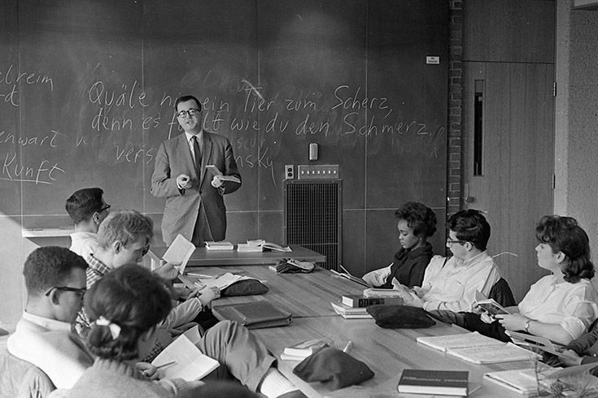
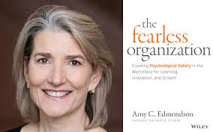
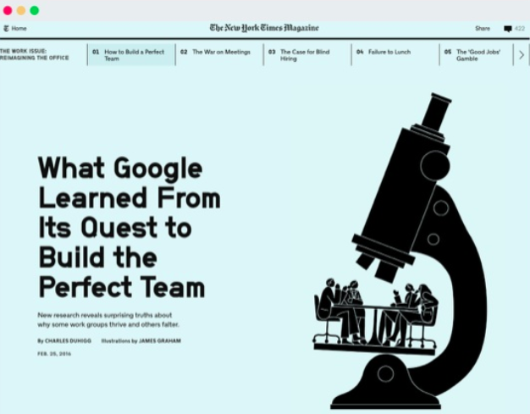
Scholars And Business
Notes:
From academia to the real world, Amy Edmondson’s bestselling books on Teaming and the Fearless Organisation researched hundreds of real-world settings on Psychological Safety
Google exploded psychological safety when they ran and published the now famous Project Aristotle research project

Slide 6
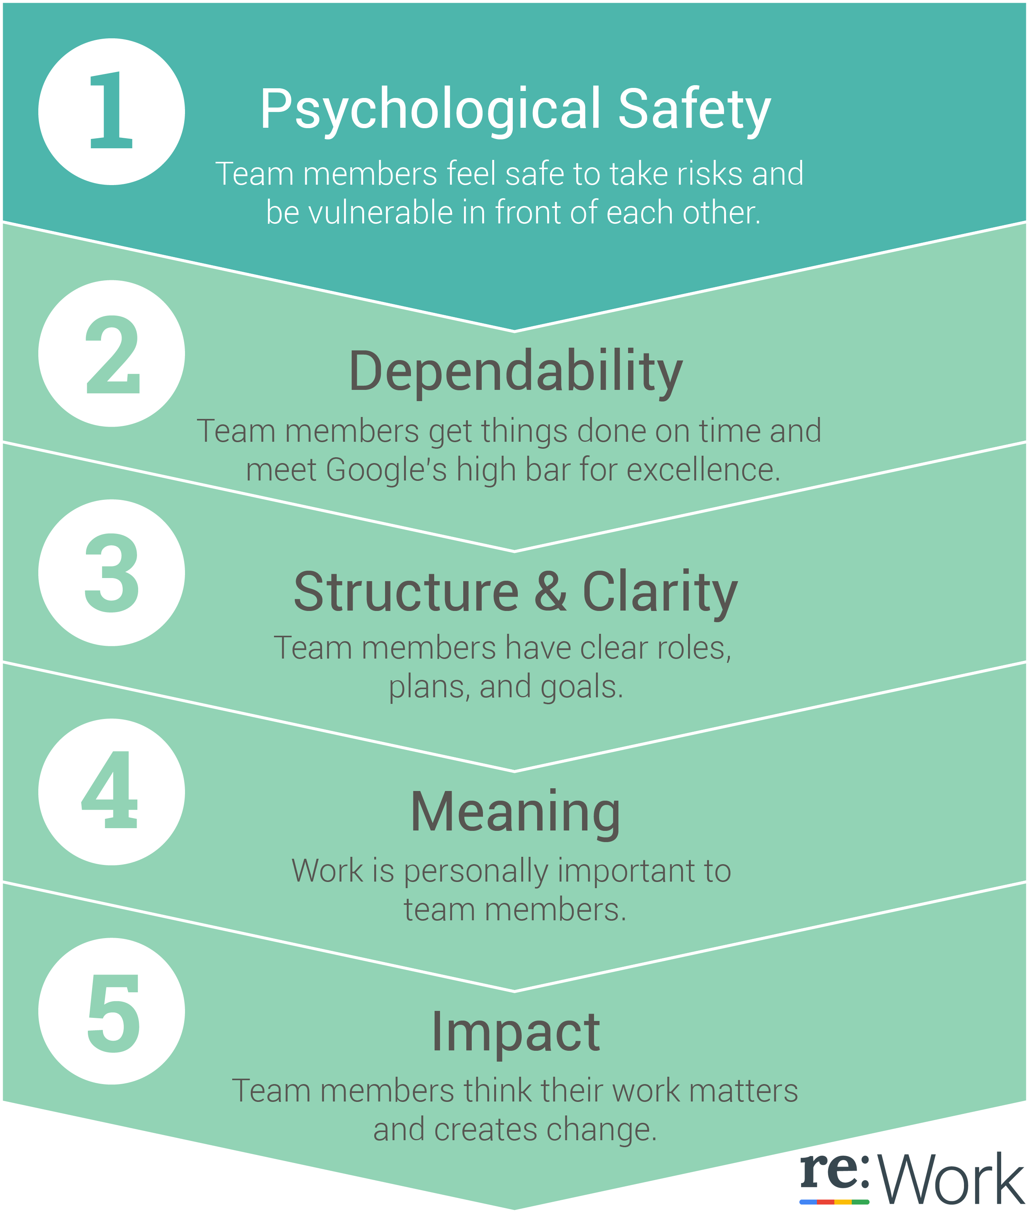
Google’s Project Aristotle
4 years
50k people surveyed
180 teams
100+ variables
ALL data showing the most important lever of high performance to be Psychological Safety
Notes:
Google’s Project Aristotle investigated a huge data set to find out what makes the perfect team?
They found that it doesn’t matter Who you put into a team, but how those people behave towards
each other and that the main behavioural lever for success a team can work on is Psychological
Safety

Slide 7

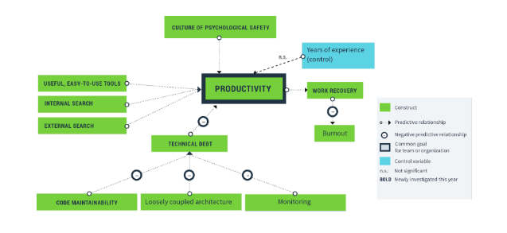
Silicon Valley’s Secret Sauce
Notes:
Then in 2019 the State of DevOps report found that a culture of Psychological Safety is the culture factor tech teams should be focusing on specifically too.

Slide 8

COMPONENTS OF PSYCHOLOGICAL SAFETY
FLEXIBILITY
MORALE
OPENNESS
COURAGE
RESILIENCE
LEARNING
Notes:
While the concept is clear and easy for anyone to connect with, what it really breaks down to and what it contains is harder to dissect. For the rest of our talk we’ll focus on the two main behaviours that signal and increase Psychological Safety but the components of the concept are these. Whether a team is PS or not depends whether they are flexible, if they are resilient, if they are engaged, if they learn together and if they are open and courageous.

Slide 9

GOOD/BAD
SPEAKING UP:
Giving input authentically, openly, courageously
Voicing concerns, fears, observed mistakes
Offering opinion and ideas
IMPRESSION MANAGEMENT:
NOT Speaking Up for fear of appearing:
INCOMPETENT
IGNORANT
NEGATIVE
DISRUPTIVE
INTRUSIVE
Notes:
First and foremost, it’s worth we we have crystal clarity. There is a positive behaviour that is desirable to have Psychological Safety: Speaking Up, Opening up, and at the opposite end, there is a negative behaviour that shows low Psychological Safety and lowers it even more every time it occurs: Impression Management, the fear that stops us from engaging in the positive behaviour.
The former is easy to understand – it refers to all the moments when we are our true selves with bravery. Opinions, concerns, ideas, anything and everything that we can offer to each other in the team dynamic.
The latter is when we have not spoken up and not been open because we were afraid we would appear either Incompetent, or Ignorant, or Negative, Disruptive or Intrusive.

Slide 10

LOOK OUT FOR IMPRESSION MANAGEMENT
Notes:
If we want to say something but we stop ourselves for fear of looking stupid, looking like we’re making things harder for others, like we’re prying or like we don’t know something or are just not very good at our job that is impression management. Other times. we fear looking unprofessional, some times we fear losing our peers’ respect if we say something. Whatever the circumstance, any time we stop, we do so out of being afraid and that lowers Psychological Safety therefore risking team performance.
Note I use “we” not “team members” not “they” not “people in general”. This is because this is common to all of us, a defensive stance we all find ourselves in often times.
Examples abound and some are very public such as what transpired about the Boeing tragedy once the emails of those who were worried but never alarms became public and so on but today we’ll also give you some that we have seen in the business world, in particular in banking
What was your Nokia moment, what was your Xerox? What would be in your Boeing email chain?

Slide 11

SPEAK UP OR ELSE
Notes:
The way we’ll do this today is by giving you one macro example of a certain behaviour or anti-pattern and then bring it back to the level of an example we’ve experienced with our clients. Eventually we’ll also give you a couple of suggestions and ideas on how to do more and build up your people practice with a focus on eliminating Impression Management to raise PS and therefore performance.
One example comes from Nokia which during the 1990s, was the top cell-phone manufacturer globally, but by 2012 it had lost this spot, along with over $2 billion and 75 per cent of its market value.
In 2015, graduate business school INSEAD study of the company’s fall, we see clearly that Nokia’s executives didn’t communicate openly about the threat from emerging competitors Apple and Google. At the same time, managers and engineers were afraid to tell their bosses that the company’s technology couldn’t compete in an evolving market. As a result, Nokia missed the opportunity to innovate and soon became irrelevant
Combating this behaviour can not be done by force or mandate. In one example we’ve seen the HR department had vowed to make people speak up and was therefore sending one department representative to every stand-up to ask developers to choose a task or pick up a ticket and then to retros to egg them to tell everyone how they felt. ”No Sarah, you go ahead now, everyone, let Sarah tell us exactly how she really feels right now, there are 4 minutes left of the meeting!”

Slide 12

NO PS AT THE TOP
Notes:
Even seemingly confident people experience moments when they find speaking up difficult and engage in impression management instead.
According to an example from Amy Edmondson’s “Fearless” where she mentions business innovator Nilofer Merchant who she was labelled a visionary by CNBC, and in 2013, she was awarded the Future Thinker Award by Thinkers50.
But in a 2011 Harvard Business Review article, Nilofer shared that while working at Apple, she would keep quiet about problems she noticed because she didn’t want to be wrong. She’s quoted as saying, “I would rather keep my job by staying within the lines than say something and risk looking stupid.” This is, of course, a classic example of impression management where she was avoiding looking ignorant but that doesn’t make her not a courageous person in general, it simply shows she wouldn’t score high on openness.
Over a period of 10 years while I worked in FinTech I met tens, or hundreds of banks and some of their boards. As soon as I left that industry to focus exclusively on the people work I started trying to understand if Psychological Safety existed at the highest level of management teams. If leaders even had a team to be Psychologically Safe in. Today I believe they do not and that indeed the levels of PS are dismal. One of the examples has to do with interviewing a leadership team of a big bank on their thoughts and feelings the night before a major meeting. 90% of them were around their appearance – (what they would wear, how they will arrive on time, all the way down to wishing they had changed phones as their screen was cracked!) or politics (who had met with whom lately, who likes who, who has what influence and who to chat to at the dinner after) and only a minute percentage was about what the actual meeting contents!

Slide 13

MEASURE ALL BUT THE HUMANS
Notes:
How will we know what people feel and when they do employ Impression Management then?
When it comes to measuring and recording how people intimately feel there is precious little in place. We have OKRs, KPIs, Retro’s around these days. Measurements and tools for all the things not the team dynamic.
Most companies have some surveys which are either rare or sterile and disengaged or punitive. Or all of the above.
Examples of the ones that measure some parts of the dynamics right – aka engagement are famously Zappos who is obsessed with both customer and employee happiness and Atlassian’s feedback system. Both focused on the importance of the feedback loop being evident and short to secure the communication channel.
In an example we’ve seen with a client, back in the day when physical offices existed, they placed three clear plastic containers by the door and employees would fill them with a coloured tennis ball to show their feeling towards the day that passed. By the next morning they would know what the overall feeling of the previous day was. Same can be done with the online community check-ins if we remember not only to ask but to display what we found out.
This is the opposite of annual surveys or 360s but it is still nowhere near analysing all the other components that lead to a healthy team dynamics and only scratches the surface. There are tools and dashboards like ours that not only tell you how you are doing but help you work better once you know.

Slide 14
REDUCE THE “HUMAN DEBT”
Focus on Team
And Psychological Safety
Train EQ for Leaders
Measurement and Actions
Organizational Permission
Notes:
While the concept is clear and easy for anyone to connect with, what it really breaks down to and what it contains is harder to dissect. For the rest of our talk we’ll focus on the two main behaviours that signal and increase Psychological Safety but the components of the concept are these. Whether a team is PS or not depends whether they are flexible, if they are resilient, if they are engaged, if they learn together and if they are open and courageous.

Slide 15
FOCUS ON THE PEOPLE WORK
Make the Human-Tasks Tickets in the Sprint
Measure for “the good”
Protect the Bubble
Obsess with the PS Conversation Space

Slide 16
FOCUS ON THE PEOPLE WORK - INTERVENTIONS
Team Re-Launches;
Courage Hackathons;
Humour Workshops;
Team B!tch Fests;
Impression Management “Catch Yourself” Counters

Slide 17

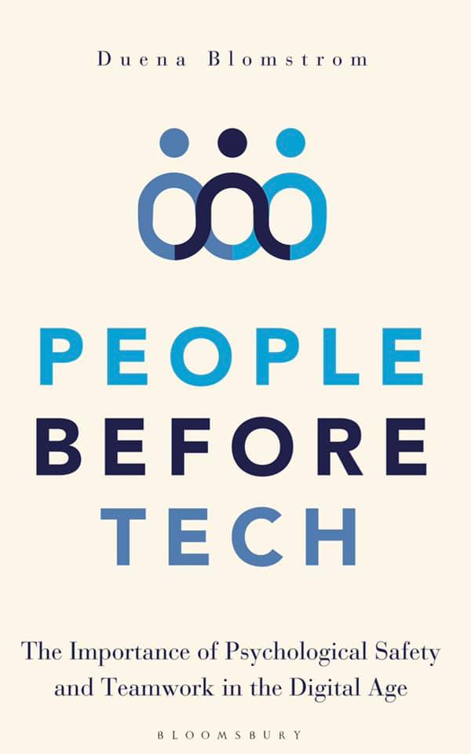
Notes:
Our answer to the above is a very hands-on one. We’re not big on theory only which is why PeopleNotTech self-ironically named such when are a software house and not a consultancy.
While there is a book coming out in May which is chiefly focusing on the intersection between Psychological Safety and Agile.

Slide 18
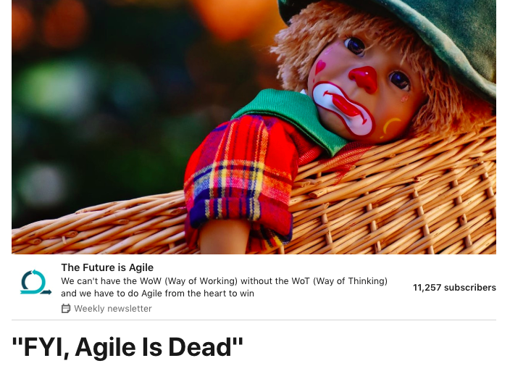
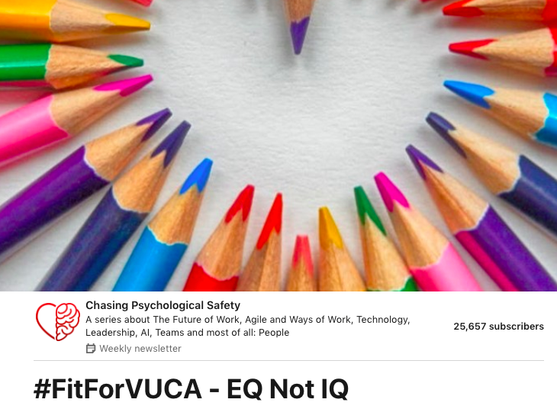
Notes:
And there are two differed newsletters to be found on LinkedIn and YouTube every week – Chasing Psychological Safety on Mondays and Tuesdays and The Future is Agile on Wednesday

Slide 19
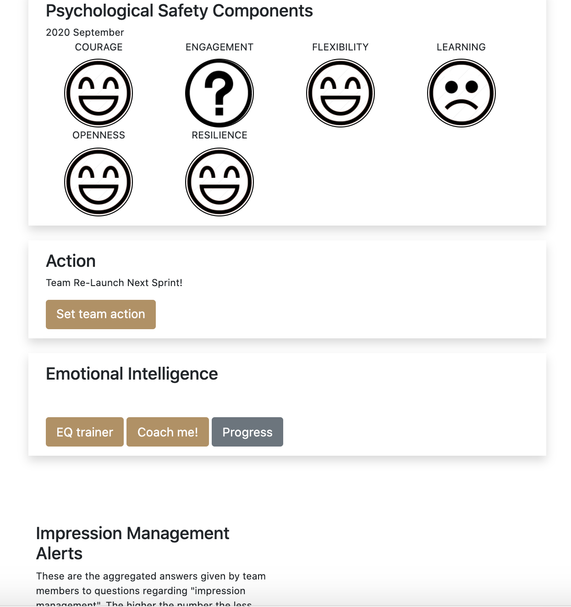
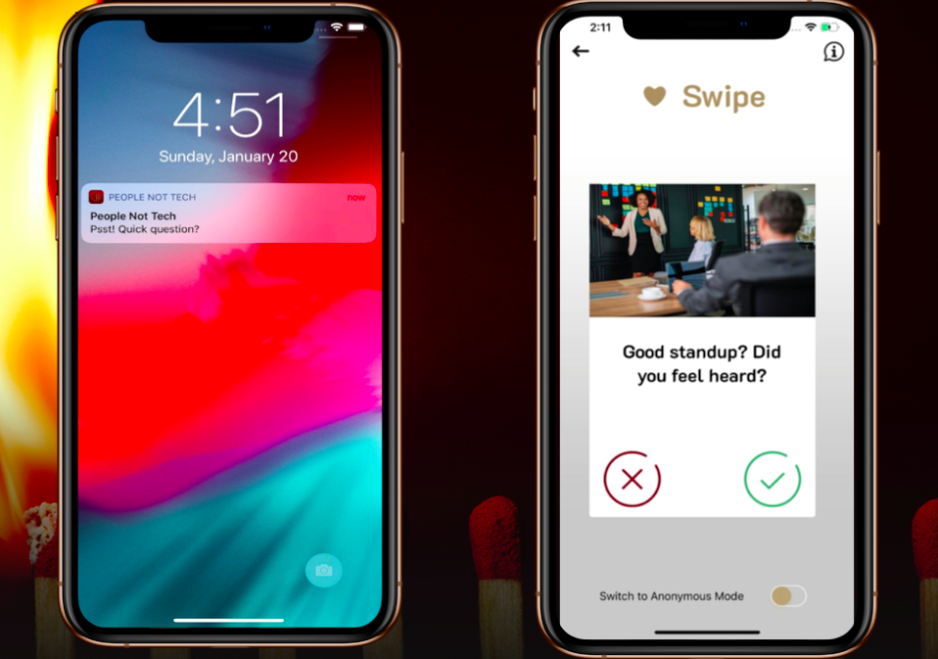
PSYCHOLOGICAL SAFETY TEAM DASHBOARD
Notes:
What we really make is a piece of software. The first solution focusing exclusively on measuring Psychological Safety by looking at behaviour as well as declarative answers and displaying it in a people- action driven way. Beyond engagement and trust we also look at how flexible a team is, how resilient, whether they learn together, if they are courageous and send out alarms when Impression Management happens so teams have a chance to keep the positive behaviour of speaking up instead.
So come speak to us so we share some of the lessons, and if you don’t have one, give you a space to look after this – most important indicator of your future success – having psychologically safe people in your teams.

Slide 20
THANK YOU

